Slide 1
Introduction to LoopBack

Slide 2

Nice to meet you!
I’m Raymond Camden!
Developer Advocate for IBM
LoopBack, Bluemix, OpenWhisk, Cordova/PhoneGap, Node, and web stuff in general
Blogging at www.raymondcamden.com
Tweet at @raymondcamden
Warning: Star Wars/Cat person

Slide 3
Why LoopBack?

Slide 4

Why LoopBack indeed….
Built on Node
Easy to Use
Open Source
Laser focused on API creation…
But supports everything else too

Slide 5
Why Build APIs?

Slide 6
APIs give you…
A way to share your data or processes with others
A way to provide data for your client-side/mobile/hybrid/TV/etc app
Or both!

Slide 7


Slide 8
LoopBack
Open source framework designed for APIs
Rapid creation of Models and REST APIs
Simple ORM system for CRUD
Built on Express
Very detailed/configurable security policies
Web site: loopback.io

Slide 9
Getting Started

Slide 10
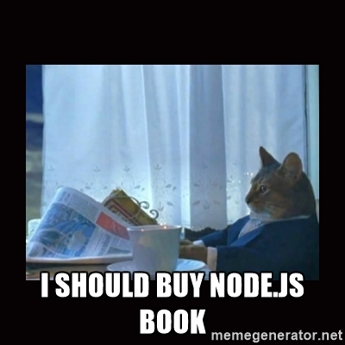
Installation
Requires npm (Node Package Manager)
Install Node.js (nodejs.org)
npm install –g loopback-cli
CLI: lb

Slide 11
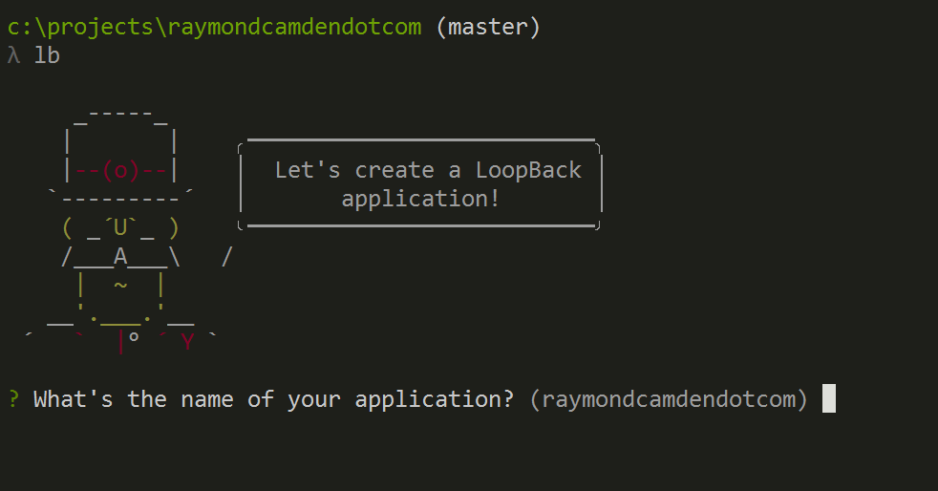

Slide 12
Creating an Application
lb
lb app
Follow the prompts and run it

Slide 13
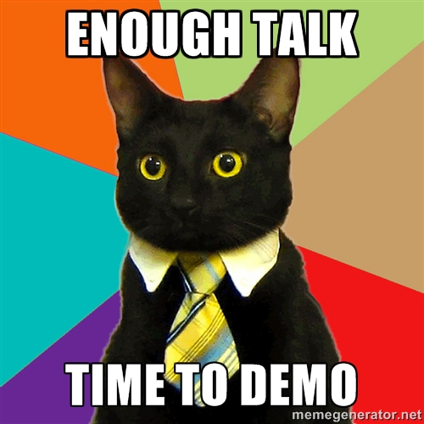

Slide 14
LoopBack and APIs
You aren’t defining an API
I want to support GET /cats
I want to handle PUT /cats
You are defining data
I work with Cats (they have names and weights)
“Ok, let me handle the API for you!”

Slide 15
Models
Models define your API
You describe properties – LoopBack does the rest (get it – “REST” heh)
Inheritance and Relationships
Out of the box – full CRUD + search APIs

Slide 17
Datasources
Where LoopBack stores stuff
Connectors define the connection (brilliant, I know)
Cloudant, DB2, Memory, MongoDB, MySQL, Oracle, PostgreSQL, Redis, SQL Server
npm install loopback-connector-mongodb –save
Roll your own

Slide 19
Security

Slide 20


Slide 21


Slide 22
Security
Security system models built in
Access Control List
What users can do what
Users can be grouped into Roles
Methods can be grouped into read/write

Slide 23
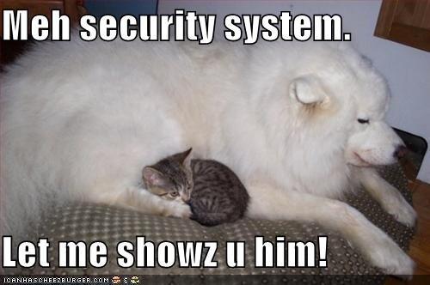

Slide 24
Customizations
Remote Hooks
Operation Hooks
Remote Methods
Stuff for Express too

Slide 26
Additional Random Stuff
File Attachments
Models based on APIs (an API for an API)
And more…

Slide 27
Resources
Main Site - http://loopback.io/
Docs - http://loopback.io/doc/
Random cool blog entries - https://strongloop.com/strongblog/category/loopback-2/
This deck plus demos: https://github.com/StrongLoop-Evangelists/preso-intro-loopback

Slide 28
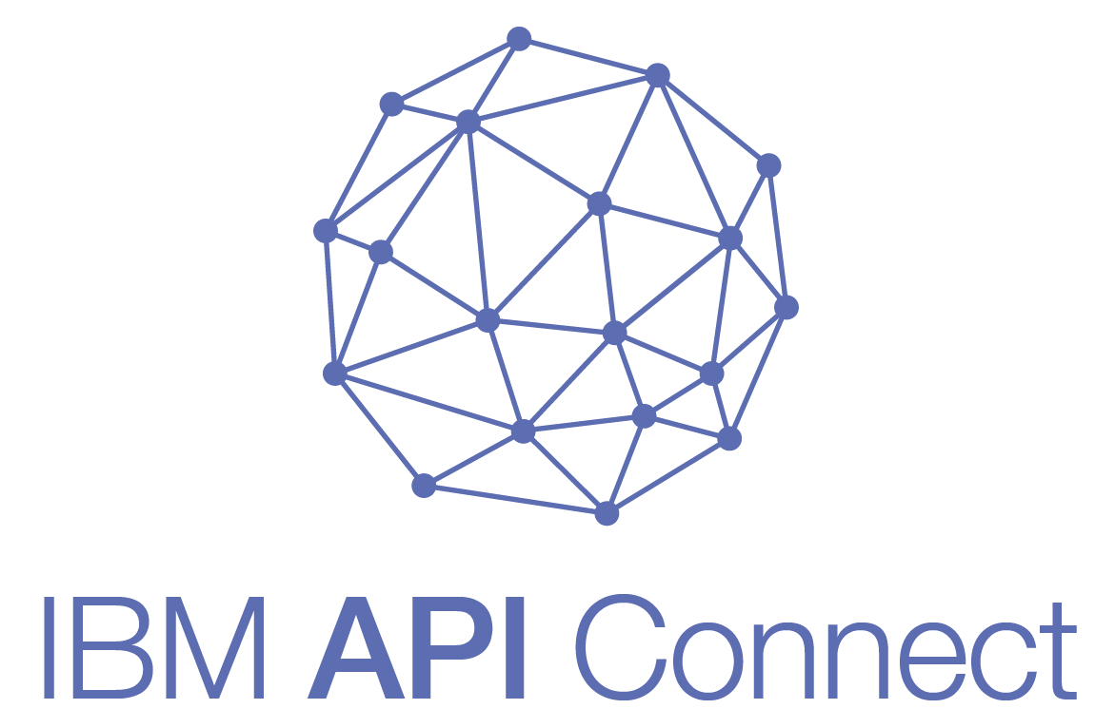
https://developer.ibm.com/apiconnect/

Slide 29


Slide 30
Notices and disclaimers
Copyright © 2017 by International Business Machines Corporation (IBM). No part of this document may be reproduced or transmitted in any form without written permission from IBM.
U.S. Government Users Restricted Rights — use, duplication or disclosure restricted by GSA ADP Schedule Contract with IBM.
Information in these presentations (including information relating to products that have not yet been announced by IBM) has been reviewed for accuracy as of the date of initial publication and could include unintentional technical or typographical errors. IBM shall have no responsibility to update this information. This document is distributed “as is” without any warranty, either express or implied. In no event shall IBM be liable for any damage arising from the use of this information, including but not limited to, loss of data, business interruption, loss of profit or loss of opportunity. IBM products and services are warranted according to the terms and conditions of the agreements under which they are provided.
IBM products are manufactured from new parts or new and used parts. In some cases, a product may not be new and may have been previously installed. Regardless, our warranty terms apply.”
Any statements regarding IBM's future direction, intent or product plans are subject to change or withdrawal without notice.
Performance data contained herein was generally obtained in a controlled, isolated environments. Customer examples are presented as illustrations of how those customers have used IBM products and the results they may have achieved. Actual performance, cost, savings or other results in other operating environments may vary.
References in this document to IBM products, programs, or services does not imply that IBM intends to make such products, programs or services available in all countries in which IBM operates or does business.
Workshops, sessions and associated materials may have been prepared by independent session speakers, and do not necessarily reflect the views of IBM. All materials and discussions are provided for informational purposes only, and are neither intended to, nor shall constitute legal or other guidance or advice to any individual participant or their specific situation.
It is the customer’s responsibility to insure its own compliance with legal requirements and to obtain advice of competent legal counsel as to the identification and interpretation of any relevant laws and regulatory requirements that may affect the customer’s business and any actions the customer may need to take to comply with such laws. IBM does not provide legal advice or represent or warrant that its services or products will ensure that the customer is in compliance with any law.

Slide 31
Notices and disclaimers continued
Information concerning non-IBM products was obtained from the suppliers of those products, their published announcements or other publicly available sources. IBM has not tested those products in connection with this publication and cannot confirm the accuracy of performance, compatibility or any other claims related to non-IBM products. Questions on the capabilities of non-IBM products should be addressed to the suppliers of those products. IBM does not warrant the quality of any third-party products, or the ability of any such third-party products to interoperate with IBM’s products. IBM expressly disclaims all warranties, expressed or implied, including but not limited to, the implied warranties of merchantability and fitness for a particular, purpose.
The provision of the information contained herein is not intended to, and does not, grant any right or license under any IBM patents, copyrights, trademarks or other intellectual property right.
IBM, the IBM logo, ibm.com, Aspera®, Bluemix, Blueworks Live, CICS, Clearcase, Cognos®, DOORS®, Emptoris®, Enterprise Document Management System™, FASP®, FileNet®, Global Business Services®, Global Technology Services®, IBM ExperienceOne™, IBM SmartCloud®, IBM Social Business®, Information on Demand, ILOG, Maximo®, MQIntegrator®, MQSeries®, Netcool®, OMEGAMON, OpenPower, PureAnalytics™, PureApplication®, pureCluster™, PureCoverage®, PureData®, PureExperience®, PureFlex®, pureQuery®, pureScale®, PureSystems®, QRadar®, Rational®, Rhapsody®, Smarter Commerce®, SoDA, SPSS, Sterling Commerce®, StoredIQ, Tealeaf®, Tivoli® Trusteer®, Unica®, urban{code}®, Watson, WebSphere®, Worklight®, X-Force® and System z® Z/OS, are trademarks of International Business Machines Corporation, registered in many jurisdictions worldwide. Other product and service names might be trademarks of IBM or other companies. A current list of IBM trademarks is available on the Web at "Copyright and trademark information" at: www.ibm.com/legal/copytrade.shtml.

